Slide 1
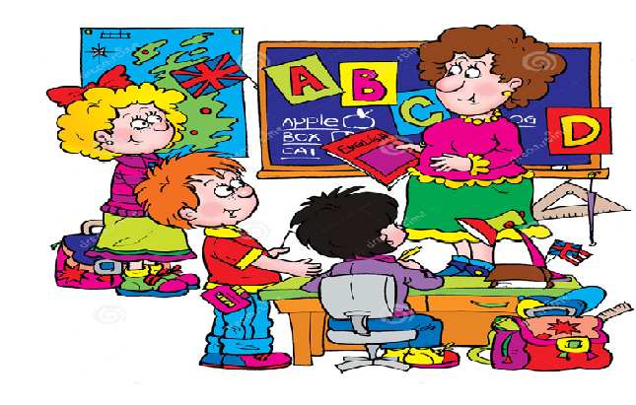
Welcome to our English class!

Slide 2

Unit 3: gerunds and infinitives
LESSON REVIEW

Slide 3
Unit 3
REVIEW
QUESTIONS
Task 1: Put the following words into the correct columns:
avoid hate remember fail finish
agree deny mind forget like
try hope prefer decide begin
+ V-ing | + to-infinitive | + sb + to_infinitive | + V-ing/ to-infinitive (same meaning | + V-ing/ to-infinitive (different meaning)

Slide 4

ANSWER
REVIEW
+ V-ing | + to-infinitive | + sb + to-infinitive | + V-ing/ to_ infinitive (same meaning) | + V-ing/ to-infinitive (different meaning)
avoid deny mind finish | agree decide fail hope expect want would like | expect want ask would like | begin hate like prefer | try remember forget

Slide 5
Task 2: Complete the sentences with the infinitives or –ing forms of the verbs in brackets:
On the way home we stopped .............(buy) a newspaper.
Can you please stop.. …... (whistle)? It’s driving me mad!
“ I can’t reach the shelf.” “ Why don’t you try ..........(stand) on a chair?”
Please try not .............(annoy) your brother!
Did you remember ..............(send) mum some flowers on Mothers’ day?
He remembers ................(play) in that park when he was little.

Slide 6
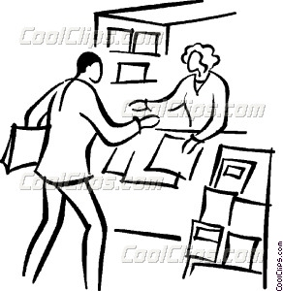

ANSWER
1. On the way home we stopped ..........(buy) a newspaper.
to buy

Slide 7
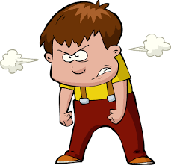
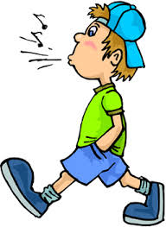

ANSWER
2. Can you please stop ...... (whistle)? It’s driving me mad!
whistling
whistle (v)

Slide 8

ANSWER
3. “ I can’t reach the shelf.” “ Why don’t you try ..........(stand) on a chair?”
standing

Slide 9

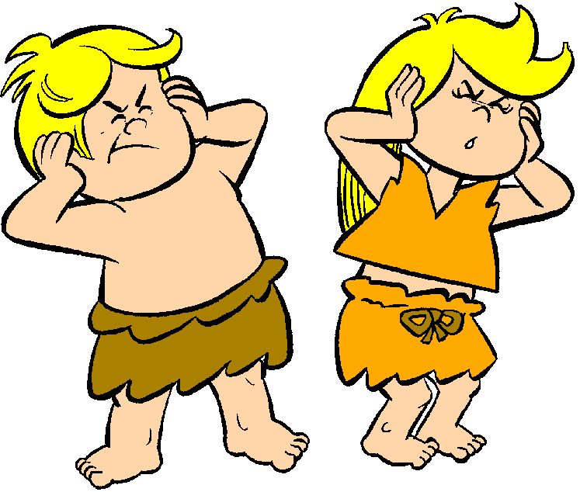
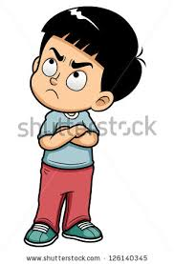
ANSWER
to annoy
4. Please try not ..........(annoy) your brother!
The noise is annoying.
They are annoyed.
annoy (v): make sb slightly angry
→ annoyed, annoying (adj)

Slide 10
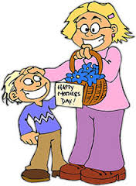
ANSWER
to send
5. Did you remember ............(send) mum some flowers on Mothers’ day?
remember + to - infinitive
1st
2nd

Slide 11
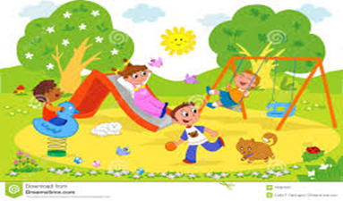
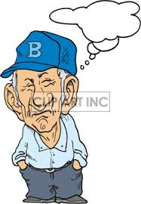
ANSWER
6. He remembers ................(play) in that park when he was little.
playing
remember + V-ing
2nd
1st
past
now

Slide 12

Part 5: Incomplete sentences
Unit 3: GERUNDS AND INFINITIVES
QUESTIONS
What techniques are used in doing this part?

Slide 13

Part 5
1. We all look forward.................you very soon.
A. to see B. to seeing
C. will see D. like seeing
+ to + V-ing
B. to seeing

Slide 14

Part 5
2. She enjoys ................ in her free time.
A. swim B. to swim
C. swims D. swimming
+ V-ing
D. swimming

Slide 15

Part 5
3. I .........you to clean your room yesterday.
A. remind B. reminded
C. mind D. minded
sb
to - infinitive
B. reminded
- remind (v): help sb remember sth
- mind (v): be upset, annoyed
or worried about sth

Slide 16
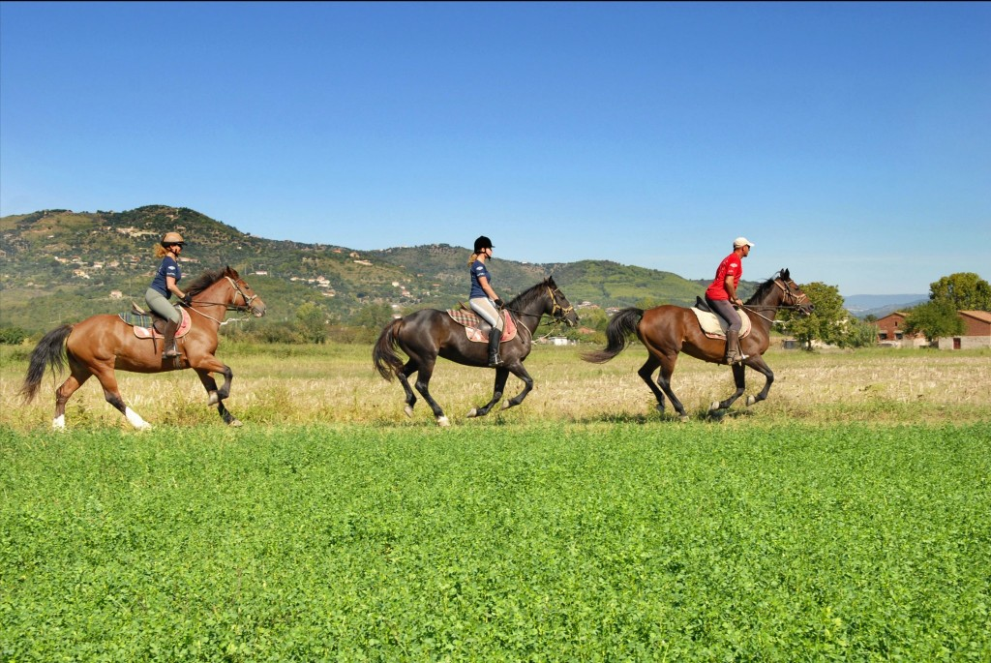
Part 5
4. Last weekend, we went horseback .......... on the farm.
A. ride B. rode
C. riding D. ridden
+ V-ing
C. riding
Go horseback riding: (American English)
Go riding: (British English)

Slide 17
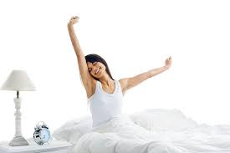
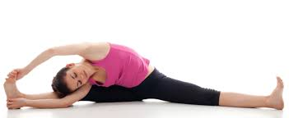

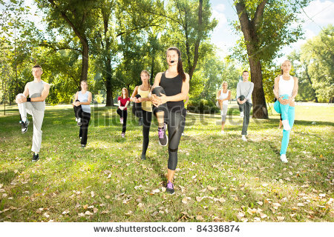
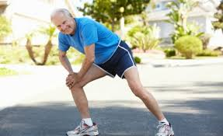
Part 5
5. My back is sore because I forgot ............... before I exercised.
A. to stretch B. stretching
C. stretch D. stretch
+ to - infinitive
A. to stretch

Slide 18

Part 5
6. My wife ............... work at the GoodAll Company.
A. was B. used to
C. was accustomed to D. interested in
B. used to
be accustomed to + V-ing: be familiar with sth as normal
Ex: He is accustomed to living in a noisy city.
interested in + V-ing:

Slide 19
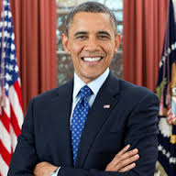
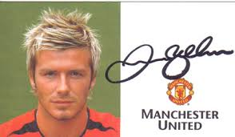
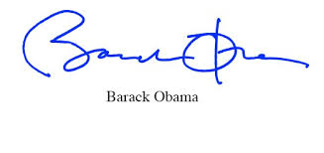
Part 5
7. The actress was tired of …...........autographs.
A. sign B. signature
C. signs D. signing
+ V-ing/ Noun
O
(V)
(N)
(singular V)
D. signing
( V-ing)

Slide 20
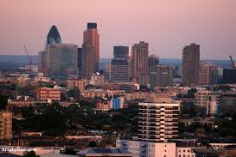
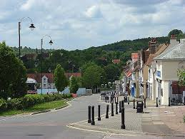
Part 5
8. Several students from the suburbs..............buses
to school.
A. get on B. getting on
C. take D. taking
S
Adv of place
V
C. take
London city
suburb

Slide 21
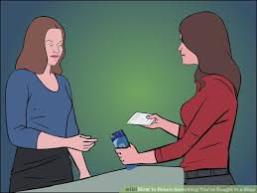
Part 5
9. The manager .............us to return the
DVD before noon today.
A. likes B. is liking
C. would like D. liked
sb
to-infinitive
C. would like

Slide 22
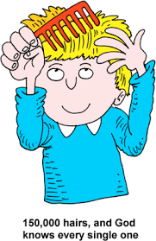
Part 5
10. Why haven’t you .............your hair yet?
A. comb B. combed
C. to comb D. coming
+ V-ed/V-3
B. combed
Have + V-ed/V-3: present perfect

Slide 23

Part 5
11. I can’t come to the party because I’m going ...........
A. shop B. shopped
C. shops D. shopping
+ V-ing
D. shopping

Slide 24
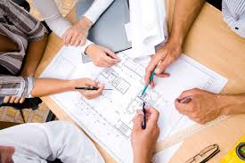
Part 5
12. My boss told me ............... the project by this Friday.
A. finish B. to finish
C. finishing D. to finishing
sb
+ to-infinitive
B. to finish

Slide 25
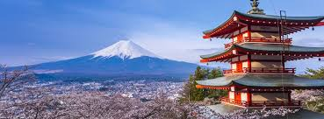
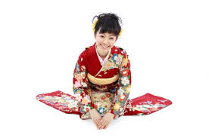
Part 5
13. That new student in class is ........ Japan.
A. at B. on
C. in D. from
D. from

Slide 26
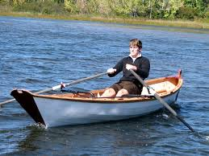
Part 5
14. It is difficult ........... from England to France.
A. row B. rowed
C. to row D. row to
adj
+ to-infinitive
C. to row
It’s + adj + to-infinitive:
Ex: It’s dangerous to drive so fast.

Slide 27

Part 5
15. I don’t have time ........for the cheapest car.
A. look B. looked
C. to look D. looking
+ to-infinitive
C. to look

Slide 28
Consolidation
1. avoid 2. agree 3. deny 4. decide 5. finish
6.give up 7.mind 8. fail 9. begin 10. tell
11. spend + money/ time 12. remind 13. ask
14. look forward to 15. hope 16. try
17. get used to = be used to 18. object to
19. can’t help 20. can’t stand

Slide 29
Task 3: Put the verbs into the correct forms
1. He decided …………….(study) biology.
2. I dislike …………….. (wait)
3. I promise ……………. (help) you tomorrow.
4. She agreed ……………. (bring) the pudding to the dinner.
5. We hope ………………(visit) Amsterdam next month.
6. We suggested ………………(go) to the museum.

Slide 30
7. I don’t fancy ……………….(go) out tonight.
8. She avoided ……………….( tell) him about her plans.
9. He enjoys ……………… (have) a bath in the evening.
10. She kept …………….. (talk) during the film.

Slide 31
11. I’m learning …………….(speak) English.
12. Do you mind ……………..(give) him a hand?
13. She helped me ……………… (carry) the suitcases.
14. I’ve finished ………………… (cook). Come and eat!
15. I would like ………………. (come) to the party with you.

Slide 32

Well-done !

